Slide 1
Lesson 1:
Introduction to Java
And the Eclipse Development Environment

Slide 2
Wholeness of the Lesson
Java is an object-oriented highly portable programming language that arose as an easy alternative to the once dominant, but error-prone, C++ language. Eclipse is one of many open source, powerful but easy-to-use integrated development environments for use with Java and related technologies. Working from deeper levels of intelligence allows one to accomplish more with less effort.

Slide 3
What is Java?
A general-purpose object-oriented language
Developed by Sun Microsystems
Based on C/C++
Designed for easy Web/Internet applications
Widespread acceptance
Why Java Became Famous ?
Platform Independent(WORA – Write Once Run Anywhere)

Slide 4
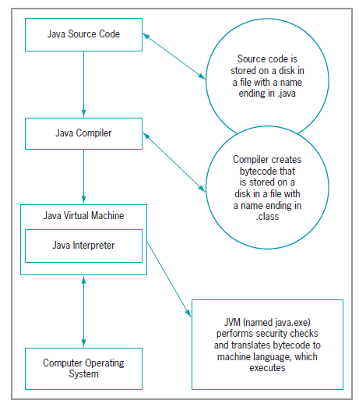
Java Environment

Slide 5
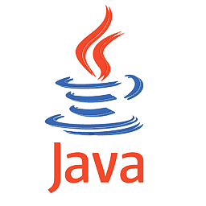

Brief History
The Java language began as a language for programming consumer electronic appliances.
Its creator was James Gosling of Sun Microsystems.
The language was first names as Oak.
The language was developed privately starting in 1991, and was made publicly available in 1994.
In 2009, Oracle bought the rights to Java from Sun Microsystems.

Slide 6
The Java Buzzwords
Simple
Secure
Portable
Object-oriented
Robust
Multithreaded
Architecture-neutral
Interpreted
High performance
Distributed
Dynamic

Slide 7
Java Features (1)
Simple
  Java has a concise, cohesive set of features that makes it easy to learn and use.
  fixes some clumsy features of C++
  no pointers
  automatic garbage collection
  rich pre-defined class library : http://java.sun.com/j2se/1.4.2/docs/api/
Object oriented
  Java embodies the modern, object-oriented programming philosophy. (Encapsulation, Polymorphism, Inheritance)
  focus on the data and methods manipulating the data
  all functions are associated with objects
  almost all data types are objects (files, strings, etc.)
  potentially better code organization and reuse

Slide 8
Java Features (2)
Interpreted and high performance
  Java enables the creation of cross-platform programs by compiling into an intermediate representation called Java bytecode.
  Byte code can be executed on any system that implements the Java Virtual Machine.
  Java bytecode was carefully designed so that it would be easy to translate directly into native machine code for very high performance by using a Just-In-Time compiler.

Slide 9
Java Features (3)
Portable
Java is architecture neutral, Java programs are portable. They can be run on any platform without being recompiled.
Moreover, there are no platform-specific features in the Java language.
the sizes of the primitive data types are always the same
the libraries define portable interfaces
Standard Unicode format
The Java environment is portable to new hardware and operating systems.
In fact, the Java compiler itself is written in Java.

Slide 10
Java Features (4)
Dynamic
  Java is designed to adapt to an evolving environment
  Java programs carry with them substantial amounts of run-time type information that is used to verify and resolve accesses to objects at run time. This makes it possible to dynamically link code in a safe and expedient manner. (Databases objects, GUI objects)
Multithreaded
  Multithreading is a program’s capability to perform several tasks simultaneously.
  Multithreading is a necessity in multimedia and network programming.

Slide 11
Java Features (5)
Robust
  To gain reliability, Java perform extensive compile-time and runtime error checking
  No pointers. Memory corruptions or unauthorized memory accesses are impossible
  automatic garbage collection tracks objects usage over time
Secure
  usage in networked environments requires more security
  Java has a relatively good security model to support use over networks and distributed environments.

Slide 12
The Java Language Specification, API, JDK, and IDE
Java syntax is defined in the Java language specification.
The Application Program Interface (API), also known as library, contains predefined classes and interfaces for developing Java programs.
The JDK is the software for developing and running Java programs.
An IDE is an Integrated Development Environment for rapidly developing programs.

Slide 13
Java Editions
Java is a full-fledged and powerful language that can be used in many ways. It comes in three editions:
■ Java Standard Edition (Java SE) to develop client-side standalone
applications or applets.
■ Java Enterprise Edition (Java EE) to develop server-side
applications, such as Java servlets, Java Server Pages (JSP), and
Java Server Faces (JSF).
■ Java Micro Edition (Java ME) to develop applications for mobile
devices
You can get the latest information about Java SE and JDK by using this link
  http://www.oracle.com/technetwork/java/index.html

Slide 14
Working with JDK
(1) Create the source file:
  open a text editor, type in the code which defines a class (HelloWorldApp) and then save it in a file (HelloWorldApp.java)
  file and class name are case sensitive and must be matched exactly (except the .java part)
  Example Code: HelloWorldApp.java
  public class HelloWorldApp {
  public static void main(String[] args) {
  // Display "Hello World!"
  System.out.println("Hello World!");
  }
  }
Java is CASE SENSITIVE!

Slide 15
Contd….
(2) Compile the program:
  compile HelloWorldApp.java by using the following command:
  javac HelloWorldApp.java
  it generates a file named HelloWorldApp.class
(3) Run the program:
  run the code through:
  java HelloWorldApp

Slide 16
Introducing Java Things to understand:
public
class
static
void
main
String[]
System, System.out, System.out.println (vs System.out.print)
delimiters: ;, }, { (“blocks”)
capitalization conventions

Slide 17
Quiz
public static void main(String[] a) { }. This statement is ____________
True b. False
Byte code is Platform dependent.
a. True b. False

Slide 18
Main Point 1
Java is a powerful object-oriented programming language that is easier to use, less error-prone, and has more portable features than C++. Science of Consciousness :Transcendental Meditation is an easy and effortless technique to make a mind clear and more alert so that we make fewer mistakes in life.

Slide 19
Integrated Development Environments
A good IDE supports compiling, running, and debugging code with tools that are integrated and typically easy to use. For a large Java project, an IDE is indispensable.
Good choices of IDE are NetBeans, Sun Forte, IBM Rational Application Developer (formerly WebSphere Application Developer), Borland's JBuilder, JetBrains’ IntelliJ
Another excellent choice, which has become an industry standard, is the open-source IDE Eclipse, written entirely in Java. We will use Eclipse in this course.
  Install JDK
  Install Eclipse IDE
www.vogella.com/articles/Eclipse/article.html

Slide 20
MAIN POINT 2
Eclipse is a leading, open-source, 100% Java, integrated development environment, which provides excellent support for editing, compiling, running, and debugging Java applications. By analogy, to create a good life, we need to handle inner life and at the same time, structure a life-supporting environment – the goal is to live 200% of life.

Slide 21

UNITY CHART
CONNECTING THE PARTS OF KNOWLEDGE
WITH THE WHOLENESS OF KNOWLEDGE
The Usefulness of Java and Eclipse IDE
Using Java, highly functional applications can be built more quickly and easily with fewer mistakes than is typically possible using C or C++.
To optimize the use of Java's features, IDE's such as Eclipse ease the work of the developer by handling in the background many routine tasks.
Transcendental Consciousness is the source from the field of pure intelligence which is the basis for successful action.
Impulses within the Transcendental Field : At this level of experience, consciousness acting within itself to produce the desired outcome.
Wholeness moving within Itself: In Unity Consciousness, the pure intelligence located in TC is found pervading all of creation, from gross to subtle.

